Slide 1
Regulation in the NHS and other high risk industries
Professional Standards Authority Conference, 9-10 March 2017
Eirini Oikonomou, University of Oxford

Slide 2
Agenda
Overview
Background/ Aims
Mapping the regulatory landscape
Reflexions
Summary

Slide 3
Background
Healthcare Regulation first appeared in 1421.
NHS Trusts accountable to several organisations.
Berwick review (2013): ‘The system is bewildering in its complexity and prone to both overlaps of remit and gaps between different agencies’.
NHS providers, Survey (2015): ‘The regulatory process is inconsistent and burdensome’.

Slide 4
Literature review
Limited empirical evidence on the impact of regulation on health care providers.
Mostly opinion/ descriptive papers/ policy documents.

Slide 5
Aims
Map regulatory landscape for patient safety in healthcare.
Illustrate the benefits and burden of regulation from providers’ level.
Contrast regulation in healthcare with other high risk sectors.

Slide 6
Mapping the regulatory landscape
Definition/ Inclusion criteria.
Classification and mapping.
Regulatory activity recording and activity overlap.

Slide 7
Definition
Regulation: Process that aims to shape, motivate, monitor and modify the practices and technologies within organizations so as to achieve some desired state of affairs (Hutter, 2001).

Slide 8
Inclusion criteria
Consider the improvement of patient safety as a part of their organisational responsibilities.
Undertake some form of monitoring or oversight of safety related to standards or performance.
Engage in formal attempts to influence other organisations' safety performance.
Derive some form of legitimacy or external authority for their work (on safety).
Score: 4/4

Slide 9
Classification
System Oversight
Regulators
Influencers

Slide 10
System Oversight
Department of Health
NHS England
Public Health England

Slide 11
Regulators
Services regulators
Professionals regulators
Products regulators

Slide 12
Services Regulators
Care Quality Commission (CQC)
NHS Improvement
United Kingdom Accreditation Service (UKAS)
Human Fertilisation and Embryology Authority
etc.

Slide 13
Professionals Regulators
General Medical Council (GMC)
General Dental Council (GDC)
General Chiropractic Council (GCC)
General Optical Council (GOC)
etc.

Slide 14
Products Regulators
Human Tissue Authority (HTA)
NHS Blood and Transplant
Medicines and Healthcare Products Regulatory Agency (MHRA)
Etc.

Slide 15
Influencers
Information and standards
Professional Peer Review and Quality Improvement
Advisory Groups
Royal Colleges
Professional Associations
National Commissioning Groups
Consultancy
Other

Slide 16
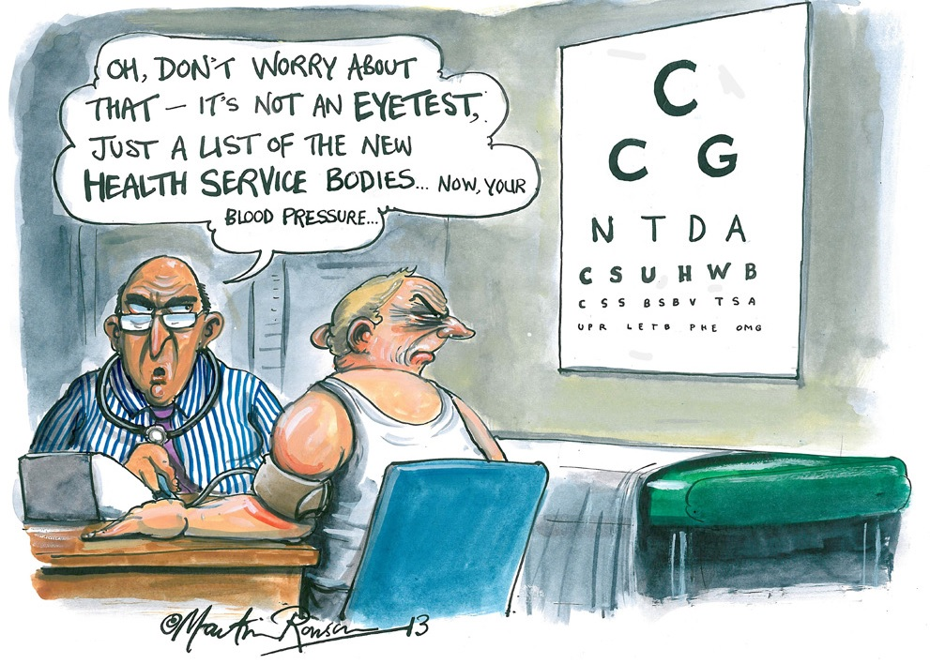

Slide 17
Activity Recording
Reviewed:
Websites
Annual reviews
Strategic plans
Meeting minutes
Recorded patient-safety related activities.
Created list of responsibilities.

Slide 18
Regulatory Activities
Set Standards
Register health care services/providers/professionals
Accreditation/Licensing/Revalidation
Policy provider
Monitor/ rate care services/professionals
Investigate
Inspect
Impose sanctions/fines/penalties
Quality improvement
Collect and analyse data and share data and information with other organisations
Advice and support the public
Advice and support health care providers/ other regulators or DH
Representation/ Advocacy/Promotion
Professional development/ Education and Training
Research

Slide 19
Regulatory Activities- Example
CQC
 Set Standards
 Register health care services/providers/professionals
 Accreditation/Licensing/Revalidation
 Policy provider
 Monitor/ rate care services/professionals
 Investigate
 Inspect
 Impose sanctions/fines/penalties
 Collect and analyse data and share data and information with other organisations
 Advice and support the public
 Advice and support health care providers/ other regulators or DH
Representation/ Advocacy/Promotion
Professional development/ Education and Training
Research
Quality improvement

Slide 20
Patterns of regulatory activity: Services
 | Standards | Register | Accredit | Policy | Monitor | Investigate | Inspect | Sanctions | QI | Data | Public support | Advisor | Advocacy | Training | Research
CQC |  |  |  |  |  |  |  |  |  |  |  | 
NHS Impr |  |  |  |  |  |  |  |  |  |  |  |  |  | 
UKAS |  |  | 
HFEA |  |  |  |  |  |  |  |  |  |  |  |  |  |  | 
HSE |  |  |  |  |  |  |  |  |  |  |  |  |  |  | 
IBMS |  |  |  |  |  |  |  |  |  |  |  |  |  |  | 
EA |  |  |  |  |  |  |  | 
NHSLA |  |  |  |  |  |  |  |  |  |  |  |  |  | 
Coroners |  |  |  |  |  |  |  |  |  |  |  |  |  |  | 
Police |  |  |  |  |  |  |  |  |  |  |  |  |  |  | 

Slide 21
Impact of regulation on Trust
Clinical Pathology Accreditation UK (CPA)
QARC
NHSLA Clinical Negligence Scheme
ISO
HFEA
Environment Agency
Connecting for Health
Cancer Peer Review
HTA
Regulatory Reform (Fire Safety)
Joint Accreditation Committee
JobCentrePlus
General Dental Council
Human Tissue Authority
IQIPS
SEL Cardiac Stroke Network
CQC
OFSTED
MHRA
London Health Programme

Slide 22
Regulator's perspective
CQC Memorandum of Understanding Agreement (MoU): 26
CQC Joint Working Protocol (JWP): 6
CQC Information Sharing Agreement (ISA): 19
Total: 51

Slide 23
Reflections
Accessing information from 400+ websites.
Keeping up with changes in landscape.
Distinguishing patient safety regulation activities.
Classifying regulatory actors who do not consider themselves as ‘regulator’.
Developing an effective data collection template.

Slide 24
Summary
Listed and classified regulatory agencies/actors in healthcare.
Monitored patient safety related functions.
Illustrated activity patterns/ areas of overlap.
Highly complex area with various actors involved.
Further insights into the impact of regulation in healthcare from case studies.

Slide 25
eirini-oikonomou@psy.ox.ac.uk

