Slide 1
Impacts of State Level Dental Hygienist Scope of Practice on Oral Health Outcomes in the U.S. Population
Building Trust in People and Places
Co-sponsored by:
Professional Standards Authority
Centre for Trust, Peace and Social Relations
Cumberland Lodge
March 9 and 10, 2017
Jean Moore, DrPH, MSN
Director
Center for Health Workforce Studies
School of Public Health | University at Albany, SUNY
jean.moore@health.ny.gov

Slide 2
The Center for Health Workforce Studies at the University at Albany, SUNY
Established in 1996
A center of the University at Albany School of Public Health
Committed to collecting and analyzing data to understand workforce dynamics and trends
Goal to inform public policies, the health and education sectors and the public
Broad array of funders in support of health workforce research

Slide 3
Today’s Presentation
Based on findings from a federally funded research study on dental hygiene scope of practice:
A Dental Hygiene Professional Practice Index by State, 2014. Rensselaer, NY: Oral Health Workforce Research Center, Center for Health Workforce Studies, School of Public Health, SUNY Albany; March 2016
http://www.oralhealthworkforce.org/wp-content/uploads/2016/08/DH_Professional_Practice_Index_By_State_2014.pdf
Also published in Health Affairs:
Expanded Scopes Of Practice For Dental Hygienists Associated With Improved Oral Health Outcomes For Adults. Health Aff (Millwood). 2016 Dec 1;35(12):2207-2215.
http://content.healthaffairs.org/content/35/12/2207
Research team:
Margaret Langelier, Tracey Continelli, Bridget Baker, and Jean Moore

Slide 4
Dental Hygiene Scope of Practice in the U.S.
Improving population oral health requires a comprehensive oral health team
Dental hygienists (DHs) primarily focus on preventive oral health services
DH scope of practice (SOP) varies considerably by state in the U.S.
Does this variation matter?
Research question: Does a more expansive SOP for DHs impact on oral health outcomes in the population?

Slide 5
Measuring Variation in DH SOP
Scope of practice (SOP) describes the legal practice environment for a health professional, including qualifications, allowable services, level of supervision, and settings where services can be provided
The Dental Hygiene Professional Practice Index (DHPPI), a numerical scale that quantifies state-specific DH SOP, was developed in 2001
Higher scores on the DHPPI are generally associated with a broader set of tasks, more autonomy (i.e. less direct oversight) and greater opportunity for direct reimbursement for dental hygienists
State-specific DH SOP was scored using the DHPPI in 2001 and again in 2014

Slide 6
DHPPI Scale: Four Overarching Components
Four components with multiple variables in each
The total possible score in an “ideal” practice environment is 100
Regulatory Environment ( max. 10 pts. – 4 variables)
Levels of Required Supervision (max. 47 pts. – 10 variables)
Tasks Permitted (max. 28 pts. – 13 variables)
Reimbursement (max. 15 pts. – 2 variables)
The DHPPI scale was factor analyzed and determined to be statistically valid
The index measures ‘possible’ not ‘actual’ practice
Scoring involved a thorough review of statute and regulation governing dental hygiene practice in each state

Slide 7
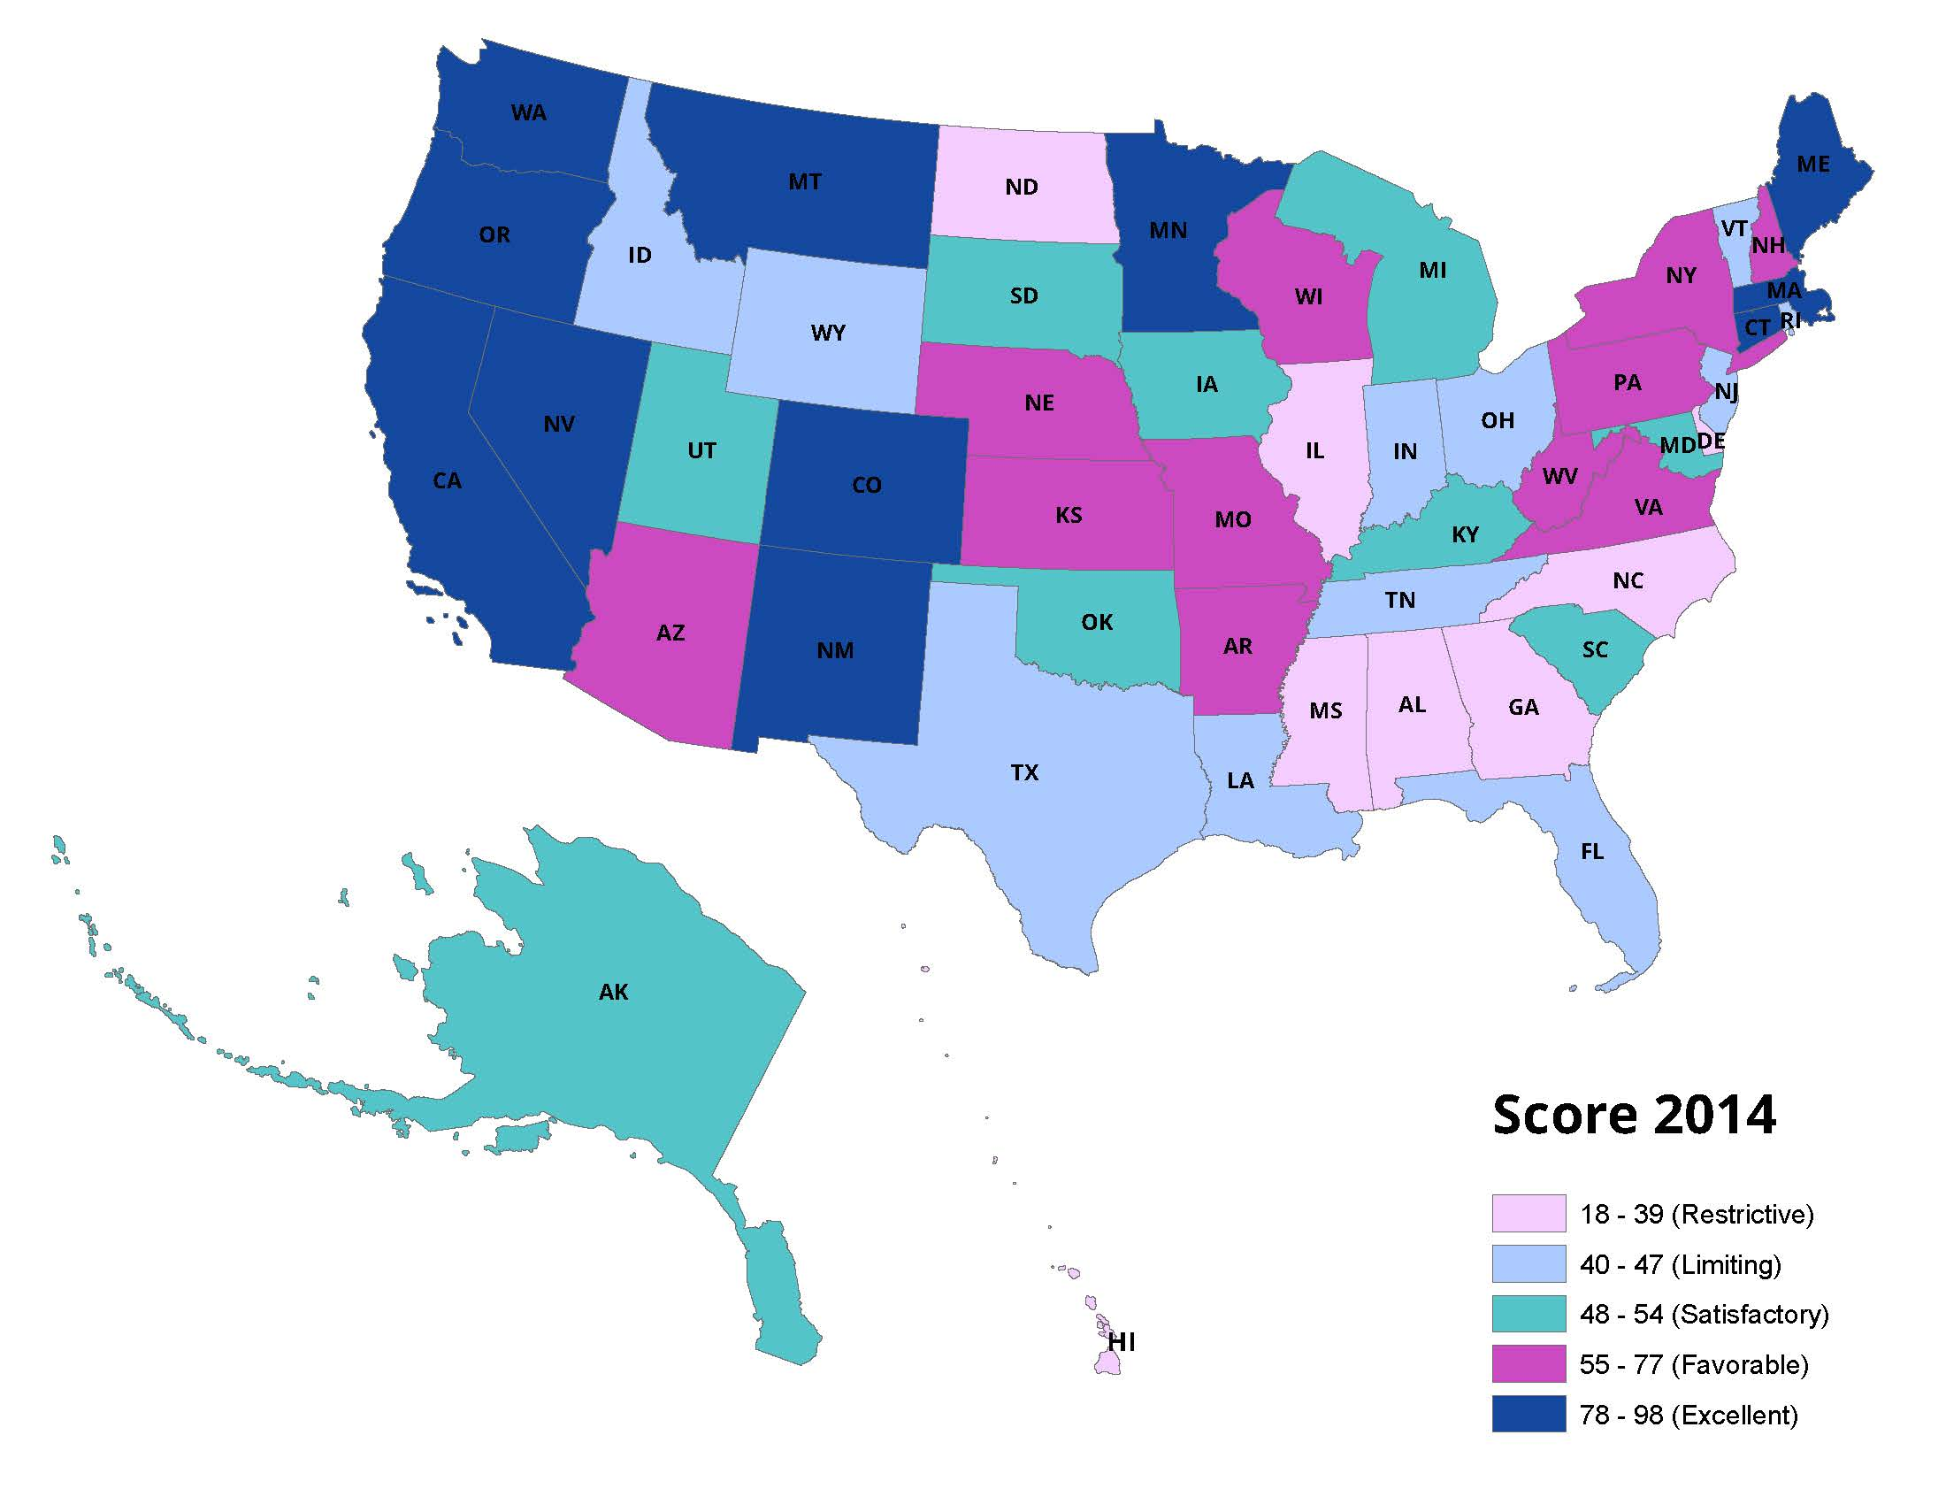
Dental Hygiene Professional Practice Index (DHPPI) State Scores
2001 DHPPI scores ranged from 10 in West Virginia to 97 in Colorado
2014 scores ranged from 18 in Alabama and Mississippi to 98 in Maine
Mean score on the DHPPI increased from 43.5 in 2001 to 57.6 in 2014
www.chwsny.org
7

Slide 8
Does DH SOP Matter? 2014 Analysis
Multilevel logistic modeling using:
2014 DHPPI scores
Behavioral Risk Factor Surveillance System individual level data describing the oral health status of individuals in states
Controlled for state and individual level factors including community water fluoridation, demographic and socioeconomic factors
Finding: More expansive SOP for DHs in states was positively and significantly associated (p<0.05) with having no teeth removed due to decay or disease among individuals in those states

Slide 9
Does the 2001 DHPPI Work Over a Decade Later?
Existing scale may not accurately assess current ideal practice for DHs
Historical scale based on the premise that lower levels of supervision would increase access to preventive oral health services
In some states the 2001 ideal has been nearly achieved
DH focus shifting to include expanded tasks and irremediable restorative services that require team based care and dental oversight or supervision

Slide 10
The 2016 DHPPI
DHs now seen as oral health preventive specialists rather than only as a dental extender
More autonomous roles
Team based care
New technologies
New settings for care delivery
Design process for the new DHPPI included a literature review and focus groups with dental hygienists
Factor analysis again confirmed the integrity of the construct
As expected, scores were lower on the new index
The variables include new workforce models including dental hygiene therapy, use of lasers, and some basic restorative tasks
Currently in the process of analyzing the impact of SOP on outcomes using the most recent BRFSS
http://www.oralhealthworkforce.org/wp-content/uploads/2017/03/OHWRC_Dental_Hygiene_Scope_of_Practice_2016.pdf

Slide 11
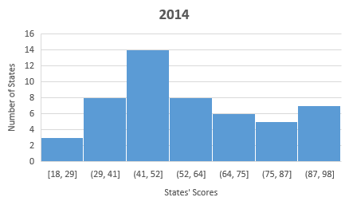
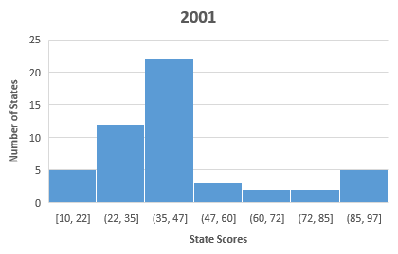
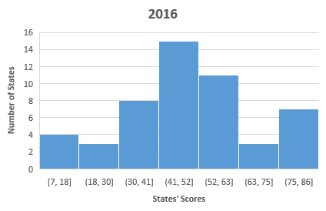
Changing Scope of Practice for Dental Hygienists – 2001, 2014, 2016
High scoring states in 2014 tended to also be high scoring on the new index (eg ME, CO, CA, WA, NM have all been classified as excellent environments at each scoring)
Some states have been innovators in expanding practice opportunities for dental hygienists (eg VT now authorizes dental therapists who must be dental hygienists)
Others have taken an incremental approach to scope of practice (eg IA classified as satisfactory at each scoring)
Low scoring states tend to remain low scoring (eg GA, MS, NC classified as restrictive at each scoring)

Slide 12
Conclusion
The DHPPI provides an objective, statistically valid measure for the professional practice environment for DHs
Research confirms the professional practice environment of DH is linked to population oral health outcomes
The updated DHPPI reflects the evolving roles for DHs
Health professions regulation must be flexible enough to support innovation while still protecting patient safety and ensuring quality of care

Slide 13
Thank you
QUESTIONS?

