Slide 1
From omni - potency to transparent competency
Scope of practice revisited in Belgium

Slide 2
Regulation of scope of practice
Law on the health care professions
Law on patient rights
Ethical codes
Reimbursement of health care

Slide 3
Law on the health professions
The great strike of the medical doctors in 1964
Creation of the law on the health professions
Distinction between autonomous and non – autonomous professions
Generic conditions

Slide 4
Law on the health professions
Negative definitions of professions and scope of practice
Only if you are a doctor, you can influence the physical or psychic condition of a person → very strictly regulated
With the exception of the medical doctor, no one can …
Gives the medical doctor the authority of “omni – potetency”!

Slide 5
Law on the health professions
Regulation of health professions based on diploma → authority
What about competency?
Eg. “ Clinical psychologist

Slide 6
Clinical psychologist
Newly regulated autonomous health profession
With the exception of the medical doctor, no one can exercise clinical psychology unless he/she obtains a recognition as a clinical psychologist
Conditions:
Masters degree of 5 years in clinical psychology
Professional internship

Slide 7
Clinical psychology: scope of practice
Within a scientific based framework of clinical psychology
Autonomous acts
Prevention
Examine
Detection
Posing a diagnosis
Counselling and treatment
Persons with psychic or psychosomatic suffering
Psychology: medical doctor as competent as an economist

Slide 8
Actual problems
Diploma: legal authority, but competent for life?
Omni – potency for the medical profession
Negative definitions creates silo’s: multidisciplinary work
Family care takers, patients experts: risk of being prosecuted
In need of a serious update

Slide 9
Towards transparent competency
Major reform in the law on the Health Professions
Law on the exercise of health professions
Law on the quality of health care
Basic principles:
Rearrangement of scope of practice
Subsidiarity: efficient and qualitative care
The organisation of multidisciplinary work made possible
Evidence based care
Patient – practitioner: pilot / co-pilot

Slide 10
Towards transparent competency
Needs?
New model on “health professions”
New model on ”scope of practice”

Slide 11
Competent practitioners
Legally ably ≠ competent
Experience
Permanent training
Special skills
A clear competency profile and control mechanism

Slide 12
Competent practitioners
From a negative to a positive more dynamic definition of health professions
Title protection and permanent database for all health professions
License as a professional identity card
New health professions

Slide 13
License
License as a professional identity card
Obligation to transparency: portfolio
Dynamic proof of competency
Subject to health care inspection

Slide 14
Multidisciplinary work
Evolution towards a functional hierarchy
Evolution towards a functional autonomy

Slide 15
Multidisciplinary work
Focus on a general professional and competency profile
Applicable for different domains in health
Regulation of access to the profession
Concept of the ”competent helper”

Slide 16
General competency profile
Professional competencies
Collaboration
Communication
Social interest
Knowledge & Science
Organisation
Professionalism

Slide 17
Access to the profession
Diploma, basic training
Recognition as a health profession
License
Competent authority
(Specialisation)

Slide 18
Patient: pilot - co-pilot
Patient needs to be the pilot
Practitioner as a co-pilot: delivering all necessary information so that the patient can become the pilot
E – health: electronic patient file as the tool
Special interest in family care takers: own legal recognition

Slide 19
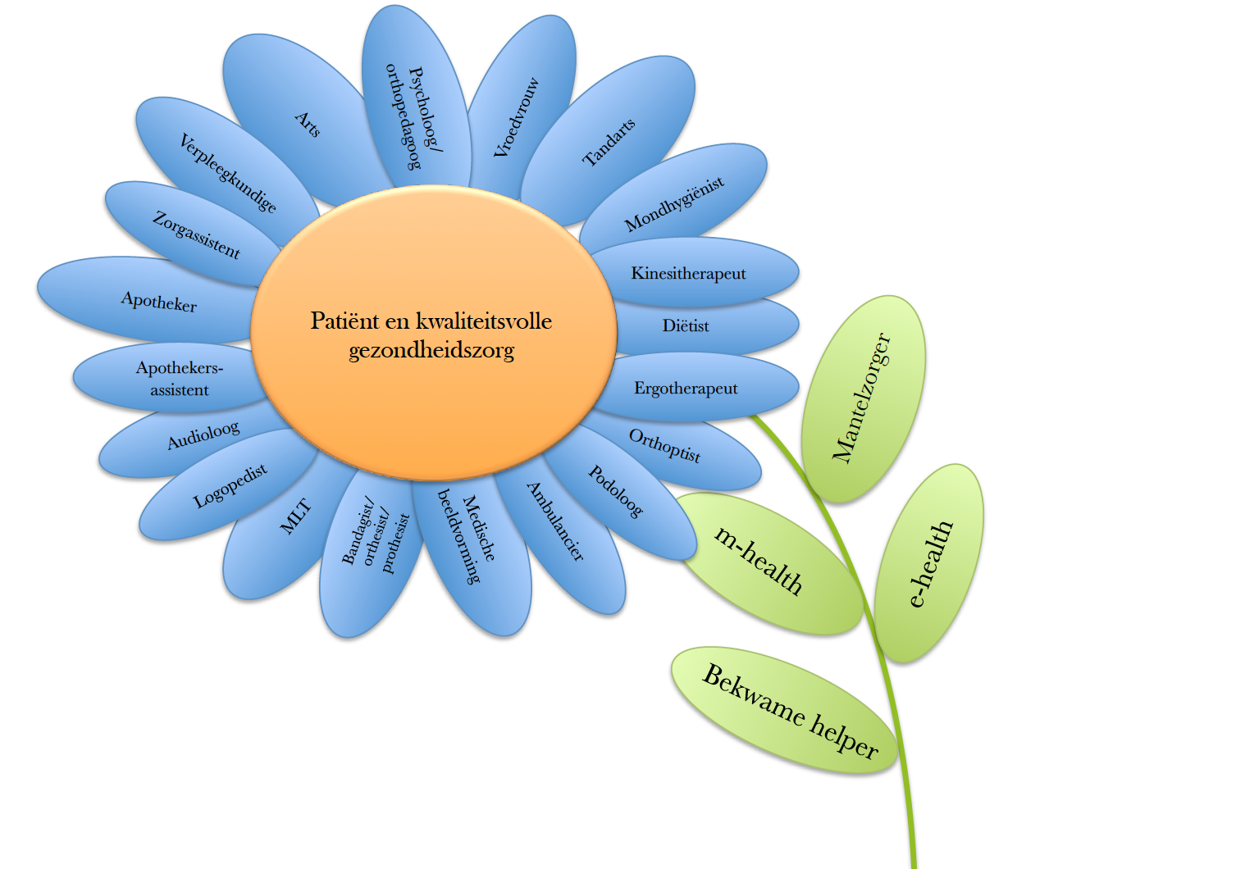
Basic idea

Slide 20
Conclusion
Interdisciplinary health care with competent health practitioners aimed at high quality

