Slide 1


Building trust in appraisal as a
proportionate route to revalidation
Dr Susi Caesar, RCGP Medical Director for Revalidation & Wessex Appraisal Service Lead

Slide 2
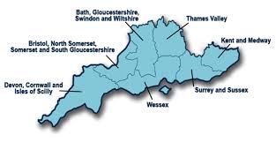
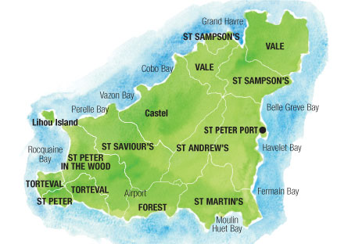
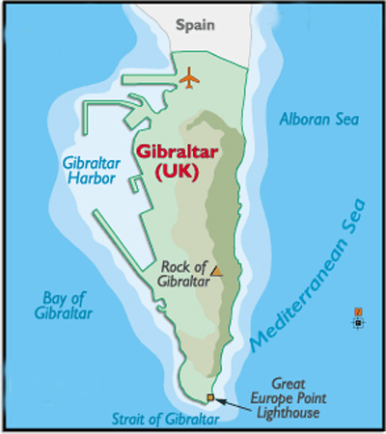
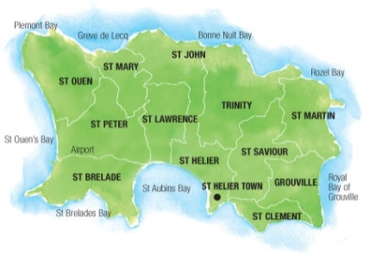
Our scope of work
Based in Health Education England (formerly the Wessex Deanery)
10 years of facilitating appraisals – pre and post revalidation
>2,500 appraisals across all sectors
>200 appraisers
Appraisal training, QA, calibration and research
Notes:
Compared with last year, the Service has expanded its area of operations.
In 2013-14, Wessex Appraisal and Revalidation Service earned its name by expanding to cover all the eligible doctors on the Medical Performer’s List for Wessex Area Team, by taking on the Isle of Wight appraisers.
Half way through the year, we also took on a contract to provide the administrative support for the responsible officer appraisals across NHS England (South).
For 2014-15, we have a new contract with the Gibraltar Health Authority to provide medical appraisals for all the employed doctors on Gibraltar across primary and secondary care.

Slide 3
What do GPs say about appraisal in general?
2015 RCGP Revalidation Survey
What proportion of respondents felt that appraisal had fulfilled its purpose in supporting quality improvements in practice?
Notes:
Guess!

Slide 4
What do GPs say about appraisal in general?
2015 RCGP Revalidation Survey
33.43%
1066 respondents
Not bad?

Slide 5
What do GPs say about Wessex appraisal in particular?
Wessex Appraisal Service Survey 2015-16
What proportion of respondents felt that their Wessex appraisal promoted quality improvements in their
work?

Slide 6
What do GPs say about Wessex appraisal in particular?
Wessex Appraisal Service Survey 2015-16
90%
1,232 respondents (55%)
Better?

Slide 7
The Wessex trend over 3 years
This is not a flash in the pan……
2013-14 89% useful for improving patient care, 92% useful for promoting quality improvements
2014-15 87% useful for improving patient care, 91% useful for promoting quality improvements in their work (1,265 respondents, 58%)

Slide 8
Does appraisal support quality improvements in practice?
33.43% vs 90%
So what’s the difference?

Slide 9
Appraisal and Medical Professionalism:
“People don’t care how much you know until they know how much you care”
David Maister (1997) True Professionalism

Slide 10
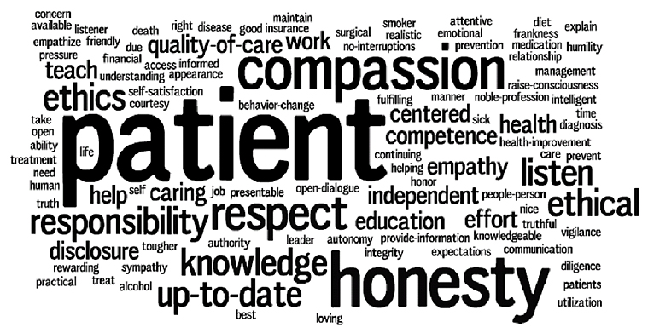
Notes:
The American Board of Internal Medicine writes the following about medical professionalism
From Kangaroo Courts and Professionalism by Pete and Margot 02.12.13
https://peteandmargot.wordpress.com/2013/12/02/kangaroo-courts-and-professionalism/

Slide 11
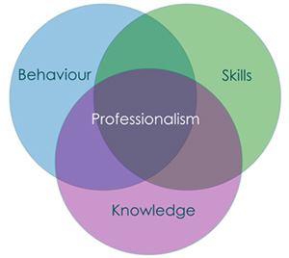
Is engagement in appraisal promoting medical professionalism?
You won’t know unless you ask…
We ask
Notes:
Karl Clough – Professionalism is priority but how do you do it?
http://www.newcastleinteractive.co.uk/newcastle-interactive-review-professionalism-is-priority-but-how-do-you-do-it/

Slide 12
Please tell us how your appraisal helped you to improve patient care?

Slide 13
Appraisal improves patient care:
“By directing my self-education and self –development”
“…encourag[ing] me to maintain high quality improvement standards”
“…interesting ideas re techniques to learn for consulting with challenging patient groups”
“Reaffirming the need to look after myself as a priority in order to look after my patients”
“increasing confidence in my work”
Notes:
Themes from the feedback from doctors in Wessex about how appraisal stimulates quality improvements in patient care:
Facilitating self-reflection
Encouraging quality improvement
Signposting resources / ideas / stimulating change
Providing support
Helping us to calibrate our standards

Slide 14
Kim Collins
“Strive for continuous improvement, instead of perfection.”
Kim Collins is a track and field sprinter from Saint Kitts and Nevis. In 2003, he became the World Champion in the 100m.

Slide 15
Daniel Kahneman
“True intuitive expertise is learned from prolonged experience with good feedback on mistakes.”
Daniel Kahneman is an Israeli-American psychologist notable for his work on the psychology of judgment and decision-making, as well as behavioral economics, for which he was awarded the 2002 Nobel Memorial Prize in Economic Sciences.

Slide 16
Bill Gates
“We all need people who will give us feedback. That’s how we improve.”
William Henry "Bill" Gates III is an American business magnate, entrepreneur, philanthropist, investor, and programmer. In 1975, Gates and Paul Allen co-founded Microsoft, which became the world's largest PC software company.

Slide 17
So why is there disillusionment:
The “burden” of regulation across more than just appraisal
The difficulties of bringing a subconscious habit (reflection) to consciousness and capturing it
The difference between reflecting and demonstrating/documenting reflection
The fact that we see ourselves as medical professionals who “would have done this anyway!”

Slide 18
…doctors are already professionals
“I feel I have always driven myself for personal and professional development both before the appraisal process began and subsequently. I don't feel appraisal has changed this”

Slide 19
Improve trust by…
reducing the burdens and improving the appraisal experience for doctors
creating well trained and supported appraisers who are focused on quality improvements in practice
capturing and disseminating examples of good practice
ensuring that the whole scope of work is covered
bringing reflection to conscious awareness and helping the appraisee to capture it
facilitating engagement in a meaningful PDP

Slide 20
Discussion
So, the public have a system in place they thought has been there for years
  But how assured can the public be?
  How can we measure public confidence in revalidation?

Slide 21
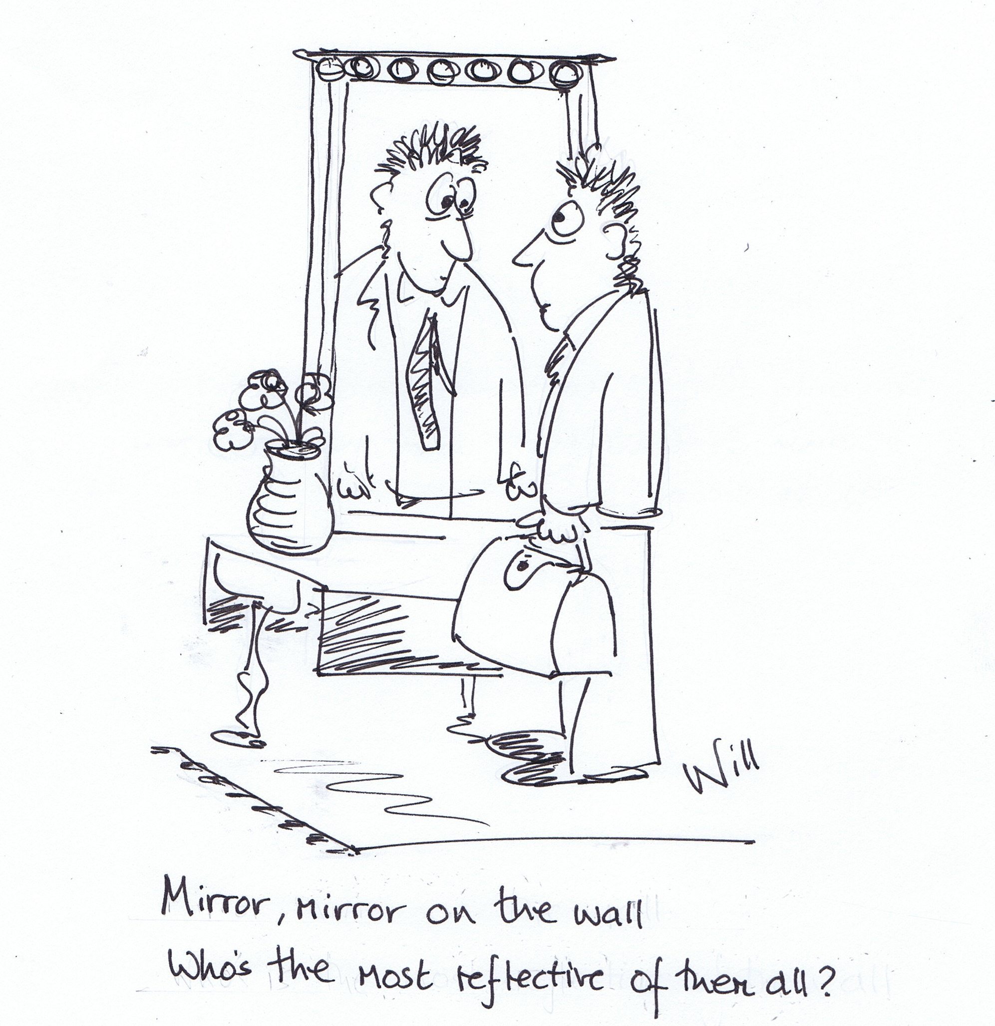
Cartoon by Dr Will Liddell, FRCGP, Associate Dean, Wessex Appraisal Service

