Slide 1
Values, standards and the real world: regulation in context
Tim Walker, Chief Executive
11 March 2016

Slide 2
Aims of session
A number of topics to explore:
How regulation contributes to goals of patient safety and the enhancement of patient care
How we show that regulation contributes to these goals
How research, policy and regulatory expertise can jointly contribute to this field
Notes:
Before I start today I want to say that many of the ideas in this presentation have their origins with my colleague, Fiona Browne, who can’t be here today.
This presentation is an exploration of some our thinking around values and standards and a request for help for us to take these ideas further.

Slide 3
What do we think is the problem?
Regulation should promote patient safety and enhance the quality of patient care
But we don’t know whether it does this and, worse, we have some evidence that regulatory interventions can impede this goal
We need to develop a far better understanding of the potential and actual impact of a range of regulatory interventions
Notes:
So what do we think is the problem?
While we are judged by the PSA among others as a regulator that performs well and is even at times quite innovative, I would argue that like all of our fellow regulators we are really in the dark about what we are doing.
We know that regulation should promote patient safety and enhance the quality of care but, except in a limited number of circumstances, we can’t really say whether it does.
Worse, we even have evidence that in some circumstances our interventions can have the opposite effect, particularly for those who have experienced the direct intervention of the regulator, or for multi-factorial reasons resort to overly defensive practice or gaming of a system which they really only see as a tick box exercise.
As regulators we need to understand clearly the impact of regulatory interventions to know if they contribute to our goals or not.

Slide 4
Chronology of regulation
‘Upstream’
FtP
Point of Harm
Time
Notes:
This is an adaptation from a diagram of Malcolm Sparrow’s where he rightly identified that for most of us as regulators the majority of our effort is expended after harm has been done rather than ‘upstream’ where our work should be contributing to the avoidance of harms.
At a meeting a few weeks ago I heard Niall Dickson say ‘upstream is a big country’.
I will forgive him the mixed metaphor because it is quite helpful.
Much of the time we see what we do as regulators in a linear fashion – education, standards, revalidation, fitness to practise etc – a sort of source to sea, graduation to retirement approach.
Really we should start to recognise that upstream really is a country – it is a landscape filled with hills and dales, rivers and swamps – all impacting on the potential of practitioners to do a good job.
Regulators are just one part of that landscape of influences contributing to the behaviour of a practitioner.

Slide 5
What is regulation?
Regulation is not:
A set of statutory functions
Undertaken by one body – the regulator
Linear
Abstract
So what is it?
Notes:
So what is regulation?
Perhaps we should start with what it is not.
I think it is a mistake to start from the assumption that regulation is a set of statutory functions. This is partly the trap that Law Commission fell into when it set out on its hunt for a better kind of mousetrap.
We also know that the regulator for any particular profession does not automatically have the greatest regulating influence on the behaviours of its registrants.
We also need to stop thinking that good practice is something that we own as regulators. Good practice (and bad practice for that matter) is an emergent property from a wide range of influences on the individual practitioner.
I also think that we are mistaken if we think there is a causative, linear relationship between what we say and what our registrants do. Even if we assume that they will always behave rationally.
And what we do can not be abstract from practice, we cannot simply hand down missives from on high and expect them to be observed. The age of deference is long over.
So what is it?

Slide 6
Redefining regulation
‘a rule, principle, that governs procedure or behaviour’ – Collins Dictionary
‘holistic construct which is linked to a range of attitudes and behaviours, including meta-skills of situational awareness – Illing, J. et al
‘health professionalism signifies a set of values, behaviours and relationships that underpin the trust the public has in professionals’ – Royal College of Physicians
Process
Context
Behaviours
Values
Standards
Notes:
We have moved a long way from the idea of ‘the autonomous self-managing expert’ but we are still bogged down in the idea that we can take a legal, mechanistic approach to professionalism being all about competence, standards and compliance, rather than something that is far more fluid, driven by the application of values and situational awareness.
The PSA’s Rethinking Regulation report was correct that we need to rethink our concept of regulation and define it differently.

Slide 7
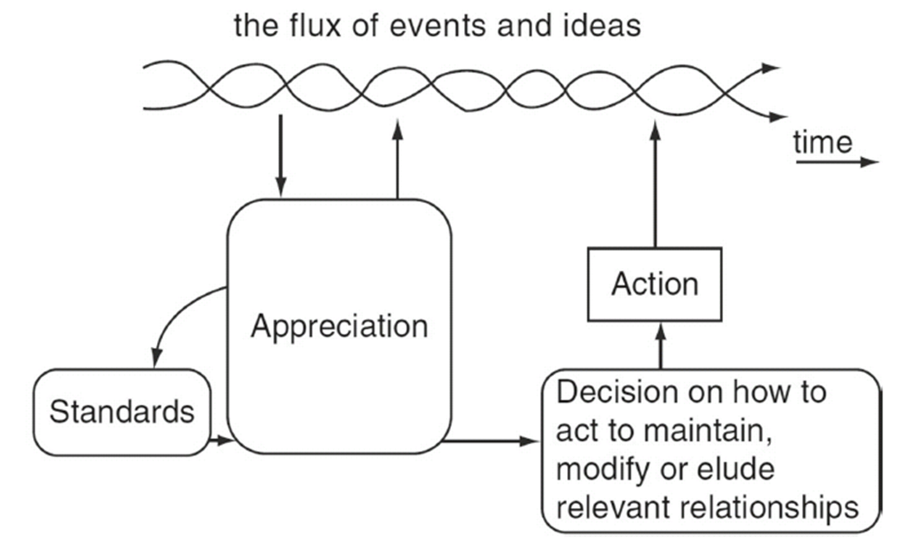
Redefining regulation
Vickers’ appreciative systems model, Checkland and Casar (1986)
Notes:
One model that I find attractive is to consider regulation to be an ‘appreciative system’.
This diagram was not developed with regulation in mind but I think it fits well.
‘The flux of events and ideas’ is the real world of professional practice but must also include the complete range of influences – including that of patients – on our registrants, their profession and the health system in which they work.
The regulator’s role is to ‘appreciate’ those events and ideas, set ‘standards’, and take appropriate actions that influence the future behaviour of the system and those within it.
The critical point here is the role of ‘appreciation’ and the regulator’s constant engagement with the ‘real world’, so that the actions it takes to influence the future is constantly informed from a wide range of sources.
But part of that appreciation must also be the regulator explaining its role, its actions and its values to the community it is aiming to influence, and vice-versa
Another way of thinking about this is as a learning system, in which the regulator, registrants and others are all participants.

Slide 8
Learning from other research
HCPC, Preventing small problems from becoming big problems in health and care
GOsC, Exploring and explaining the dynamics of regulation, professionalism and compliance with standards in practice
GMC, Factors that encourage or discourage doctors from acting in accordance with good practice
SRA, Attitudes to regulation and compliance in legal services
Notes:
There is a wide range of relevant research that supports this thinking covering a variety of key issues, including:
Professional engagement
Practitioner isolation
Personal motivations
Conscious and unconscious non-compliance
The influence of innate qualities as well as external influences.
What this shows is that we are not just dealing with objective situations but a range of behaviours, reactions, activities and emotions.

Slide 9
Redefining standards
Level | Activity | Definition
1 | Overarching values/ principles | Possible inclusion of a set of high-level over-arching values/principles. Alternatively, reflect those developed and owned by the profession (e.g. Patient Charter’).
2 | Standards | The 37 Osteopathic Practice Standards – ‘must statements’.
3 | Guidance | Supporting information that helps to underpin the Standards.
4 | Learning resources/ decision making resources | Communication and engagement and including: material explicitly linked to the OPS, providing more explicit explanation of why standards are in place, and contextual material about how they apply in practice. Decision making frameworks to support professional judgement.
Notes:
In our own work we have started to rethink the way in which we develop and implement our standards.
At the moment our model – which is not dissimilar to other regulators – operates at levels 2 and 3 of this table. We have a set of standards (must statements) which are supported by a range of guidance.
We are now looking at two new areas.
First, is whether we can develop an overarching set of values or principles that sit above or alongside the standards. These may or may not need to be owned by us as the regulator, they could be owned by the profession itself.
Then most importantly we are looking at the materials that underpin the guidance – more narrative about the purpose of standards, learning materials, decision-making frameworks and anything else that might actually be deemed useful by the professionals we regulate.
Importantly we are also realising that at the fourth level we need a much more dynamic approach. Not just something that is reviewed and changed every five years.
As an aside, I wonder whether the reason why social media has become such a hot topic in the regulation world is not to do with the subject matter, but more to do with the fact that it changes more rapidly than the regulatory standards themselves?

Slide 10
Understanding values/next steps
Interactive workshops and sessions with osteopaths, patients and other health professionals to explore common and conflicting values.
Identified lack of decision-making frameworks
Next steps
Develop decision-making frameworks
Test with osteopaths and patients using validated patient feedback tools
Develop the evidence for whether regulatory interventions really can make a difference
Notes:
Taking a much more contextual approach mirrors the work by Bill Fulford on values, which finds that the clinical decision making process must be based on both the individual patient and individual clinician values, and that information should be discerned and given with reference to these contexts as well as the evidence base for treatment.
This approach has been recently confirmed by the Montgomery judgement which provides that the information provided to the patient must be what is reasonable to that patient, rather than the Bolam test which focused on the clinician.
We have been exploring through a series of workshops how values and their relationship to standards, might help us to influence the behaviour of registrants in accordance with our standards.
This is not a small challenge. In the workshops we sought to develop a consensus on a common values framework, it fell apart when tested through more in depth case studies. Understanding common values did not help us to make more explicit what was going in the patient/clinician consultation process – that was still implicit – so while it was helpful to have professional values – it was not enough.
This has led us to identify the need for better decision making frameworks which help to make more explicit conflicting issues and areas of importance in the patient and clinical relationship, to see if this supports patient empowerment and partnership, as well as professional judgement.
As a next stage, we hope that we might be able to develop these decision-making frameworks and measure their impact through the use of the CARE Measure, a validated tool for patient feedback, to test out the effect of a regulatory intervention by reference to patient values and the quality of patient care.
In the osteopathic profession we have a small population with fewer confounding factors, because there is no NHS, teams or employers, and so we think it is easier with this population to test out some of the ideas that we outline in this presentation which may then be applicable to the wider regulatory picture and regulatory thinking.
We are keen to develop this work and would welcome your thoughts on where we are going and would be delighted if anyone wants to get involved with us in this work.

Slide 11
Questions for consideration
What are thoughts on our direction of travel?
What works well?
What other work should we be aware of?
What are the barriers or concerns?
Would anyone be interested in working with us to explore these approaches?
Notes:
So here are some questions for consideration in the discussion and we look forward to hearing your views.

Slide 12
Thank you
Tim Walker twalker@osteopathy.org.uk
Fiona Browne fbrowne@osteopathy.org.uk

