Slide 1
Putting market outcomes on the centre stage The LSBs efforts to evaluate market change Robert Cross PSA 11 March 2016

Slide 2
Overview
Who we are
Turning objectives into outcomes
Impacts and challenges
Legal Services Board

Slide 3
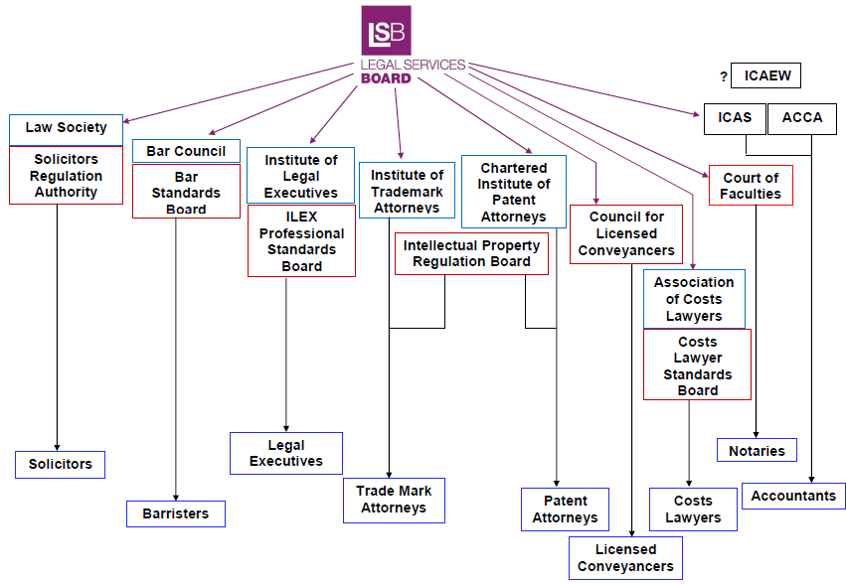
Oversight regulation
Legal Ombudsman
CILEx
Master of Faculties
CILEx Regulation
Legal Services Board

Slide 4
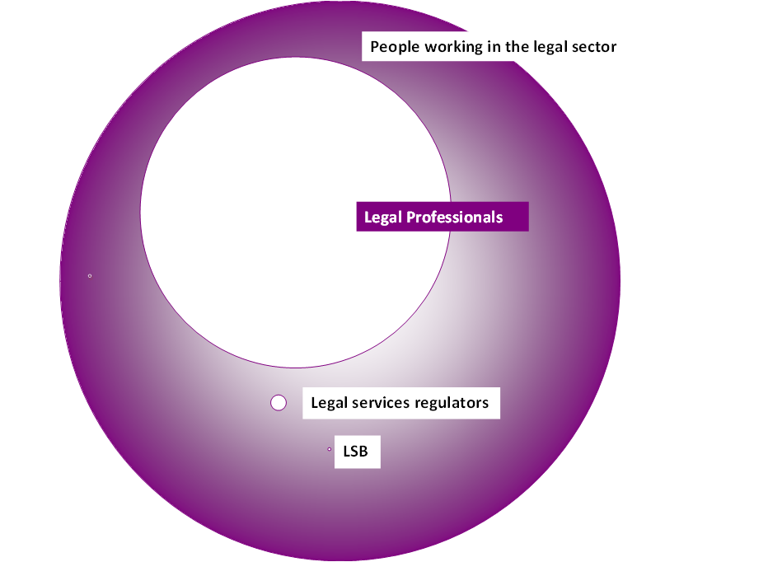
What disruption might look like
Source: ONS, ARs, LSB
Legal Services Board

Slide 5
Regulators statutory objectives
Protecting and promoting the public interest
Supporting the constitutional principle of the rule of law
Improving access to justice
Protecting and promoting the interests of consumers
Promoting competition in the provision of services
Encouraging an independent, strong, diverse and effective legal profession
Increasing public understanding of the citizen’s legal rights and duties
Promoting and maintaining adherence to the professional principles
Source: Part 1 Legal Services Act 2007
Legal Services Board

Slide 6
Overview
Who we are
Turning objectives into outcomes
Impacts and challenges
Legal Services Board

Slide 7
The Evaluation Framework (1)
Assess the outcomes associated with the regulatory objectives.
Not organisational efficiency or functional performance.
Developed via:
LSB Board workshops
Consultation with stakeholders
Economic market segmentation framework
Legal Services Board

Slide 8
Turning objectives into outcomes: 5 Perspectives, 14 outcomes
Are the regulatory objectives being delivered?
1. Provider
Diversity better matching client population
Quality has improved
2. Consumer
Higher access to justice
Profession and judiciary have confidence in legal sector
Confidence in legal services regulation
3. Public
Confidence in legal sector
Efficient legal system
Confidence in standards and ethics of the profession
4. Market
More competitive
Affordable legal services
Plurality of services
5. Investor
Market attractive to all sources of finance
Proportionate regulation
Empowered in dealings with legal services
Legal Services Board

Slide 9
The Evaluation Framework (2)
Within each outcome
Collation of available data and evidence
Regulators data
Research commissioned by the LSB and others
Observation of trends over time
Identification of knowledge gaps
Assessment based on best evidence not causation
Legal Services Board

Slide 10
Measuring quality
Quality of legal services is improved overall
Service quality
Consumer satisfaction
Service complaints
Professional conduct
Conduct complaints
Technical competence
Professional Negligence Claims
Rejection rates for processes
Insurance claims
Quality mark schemes
Legal Services Board

Slide 11
Overview
Who we are
Turning objectives into outcomes
Impacts and challenges
Legal Services Board

Slide 12
Impacts of evaluation: Example of innovation
Evaluation framework highlights desired outcome of greater plurality of, and innovation in, legal services offered
Baseline evaluation report highlights lack of information
Evaluation investigation into competition highlights continued lack of information.
LSB and SRA jointly commission research to look at levels of and barriers to innovation.
SRA introduced SRA Innovate – a support service to help firms navigate regulatory issues related to new business ideas.
Informing approaches in the Choice of Insurer project.
Legal Services Board

Slide 13
Challenges
Data issues in the sector:
History of managing membership lists
Cost benefit calculations of frontline data collection
Limited scope to mandate data collection
Limited research budget and wide variety of policy interests
Problem of isolating cause and effects:
Agents in the justice system
Wider economic factors
Time scales:
Frequency of use of legal services
Slow transmission mechanisms
Legal Services Board

Slide 14
Summary
LSB first to do this in legal services in E&W;
Outputs help focus limited LSB resources, and hold regulators to account;
Available data limited, but systematically closing gaps through research;
Seeking to learn from approach in other sectors – how can we do this more effectively?
Legal Services Board

Slide 15
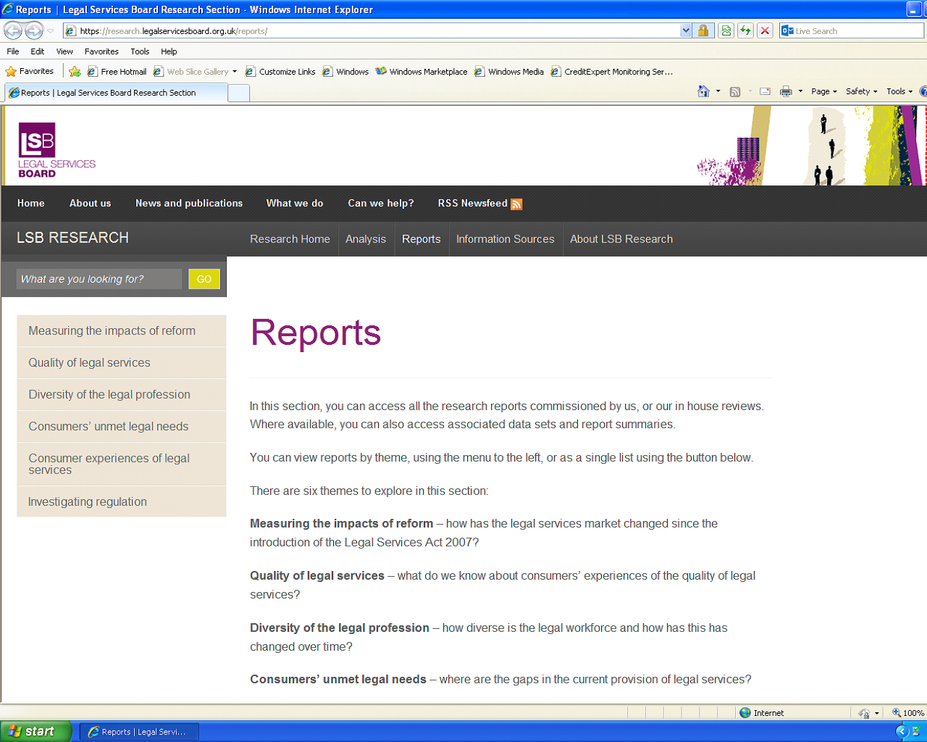
Robert.Cross@legalservicesboard.org.uk
https://research.legalservicesboard.org.uk/
Legal Services Board
One Kemble Street
London
WC2B 4AN
020 7271 0050
Follow us @ LSB_EngandWal

