Slide 1
The effects of having restrictions on practice or warnings
11th March 2016

Slide 2
What we will cover
Introduction to the research
Key findings (overview only)
Employer reactions
Short term impact on practice / behaviour
Longer term impact
Participants’ suggested improvements
The GMC response
Questions and discussion

Slide 3
Introduction

Slide 4
Overarching objective
To identify the short and medium to long term impact on doctors (and their clinical work) of restrictions on practice and warnings.

Slide 5
Method and sample
60 telephone interviews conducted
99 online questionnaires completed
Qualitative Interviews
14 doctors with warnings
26 doctors with undertakings or conditions
21 employers
Quantitative Survey
42 doctors with warnings
57 doctors with conditions or undertakings

Slide 6
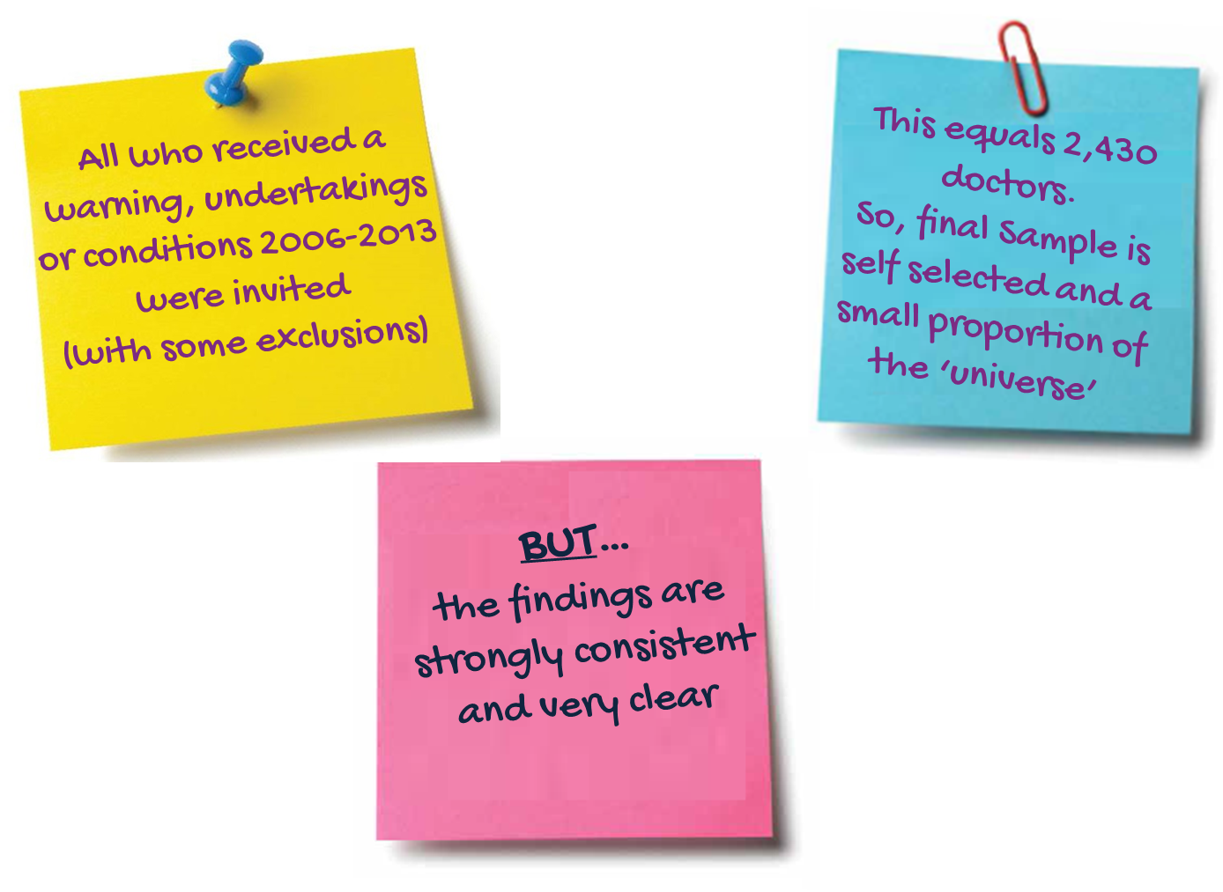
Interpretation (1)

Slide 7
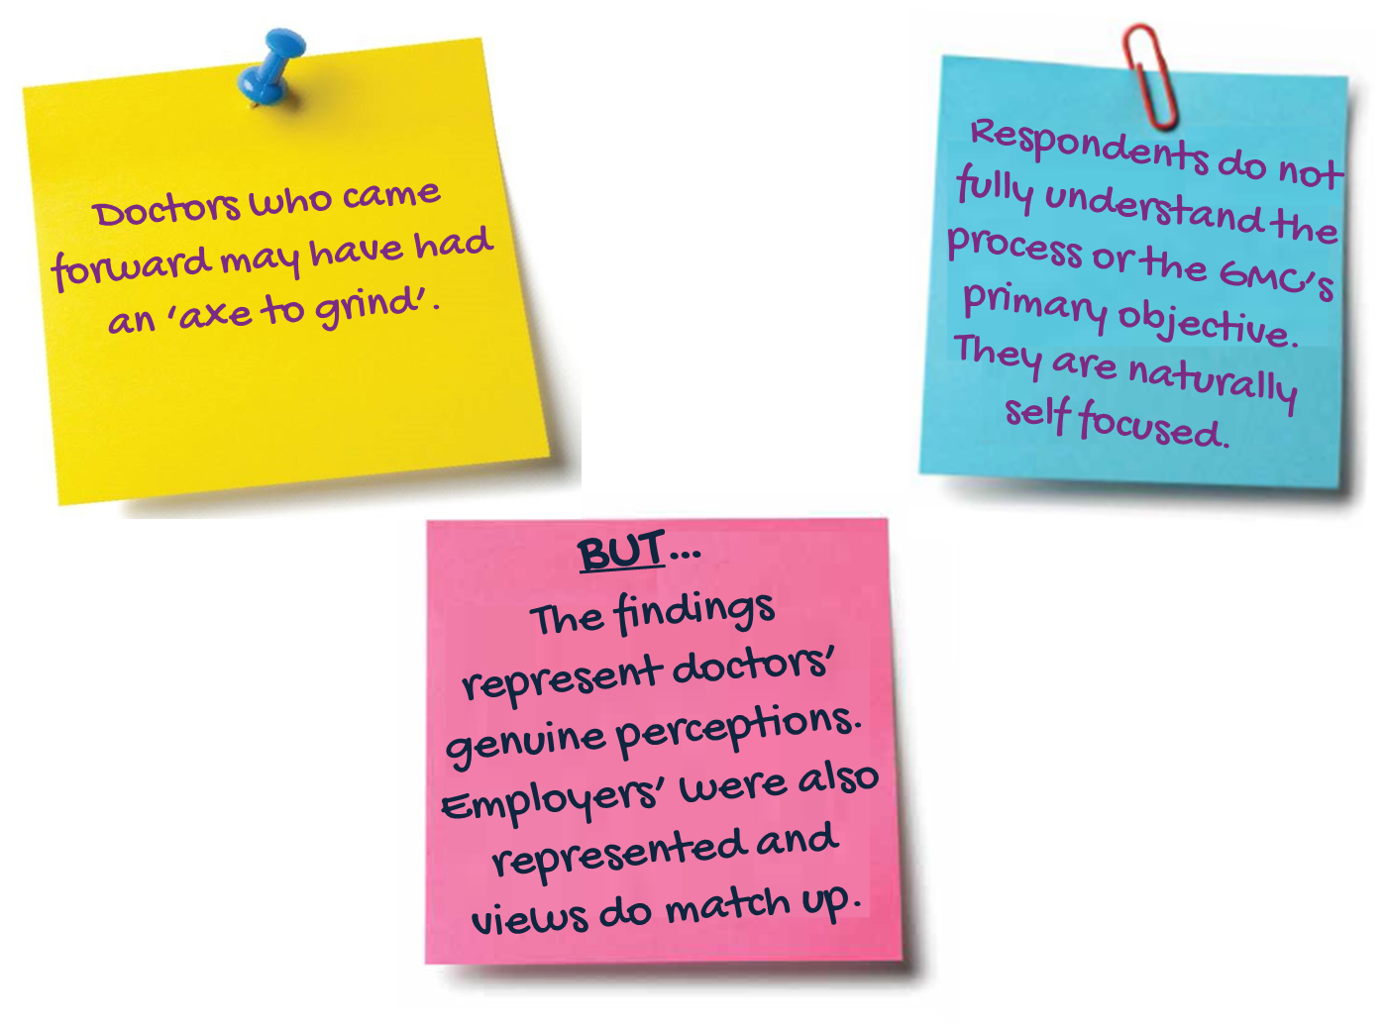
Interpretation (2)

Slide 8
Key findings

Slide 9
Factors affecting how far employers support remediation
The issue that leads to the doctor’s warning, undertaking or condition.
The value of the doctor to them, both in terms of their position and attitude and their specialist clinical skills.
The potential reputational risk involved.
The practicalities of supporting the working restrictions, including the resources needed.

Slide 10
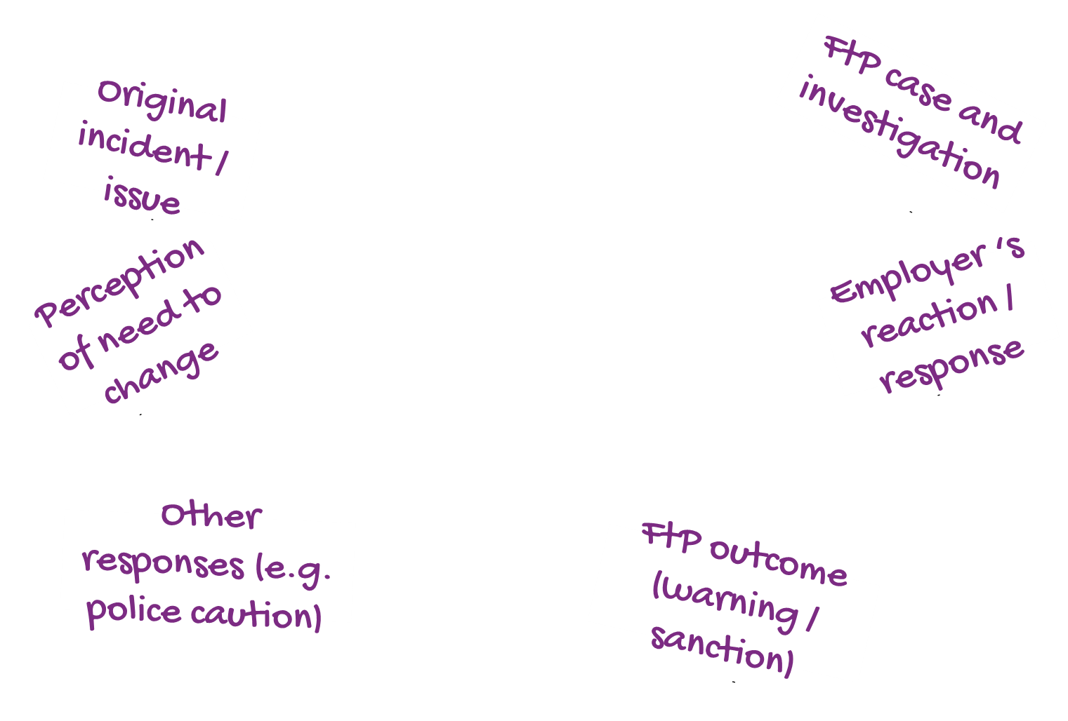
A tangled web
Changes in
behaviour?

Slide 11
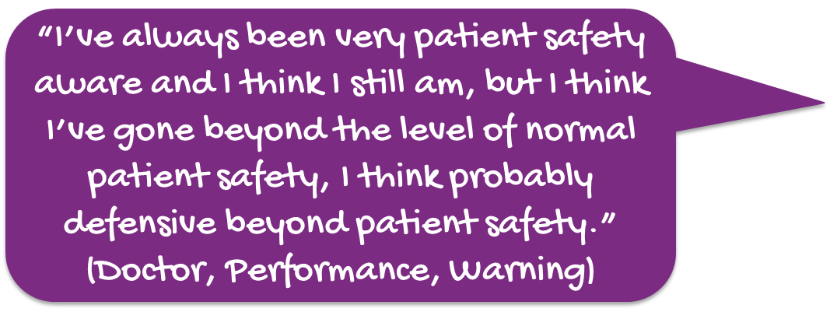
Short term impacts
More likely to reflect (those with restrictions.)
Excessively cautious.
More risk averse.
More likely to reflect (those with warnings.)
Safer practice for patients.
Improved skill as a practitioner.

Slide 12
Drivers of remediation
Recognising there was a problem in the first place.
Insight
Reflection
Thinking about how to improve practice in the future.
Setting up and working positively within restrictions (without resentment.)
Positive engagement with restrictions

Slide 13
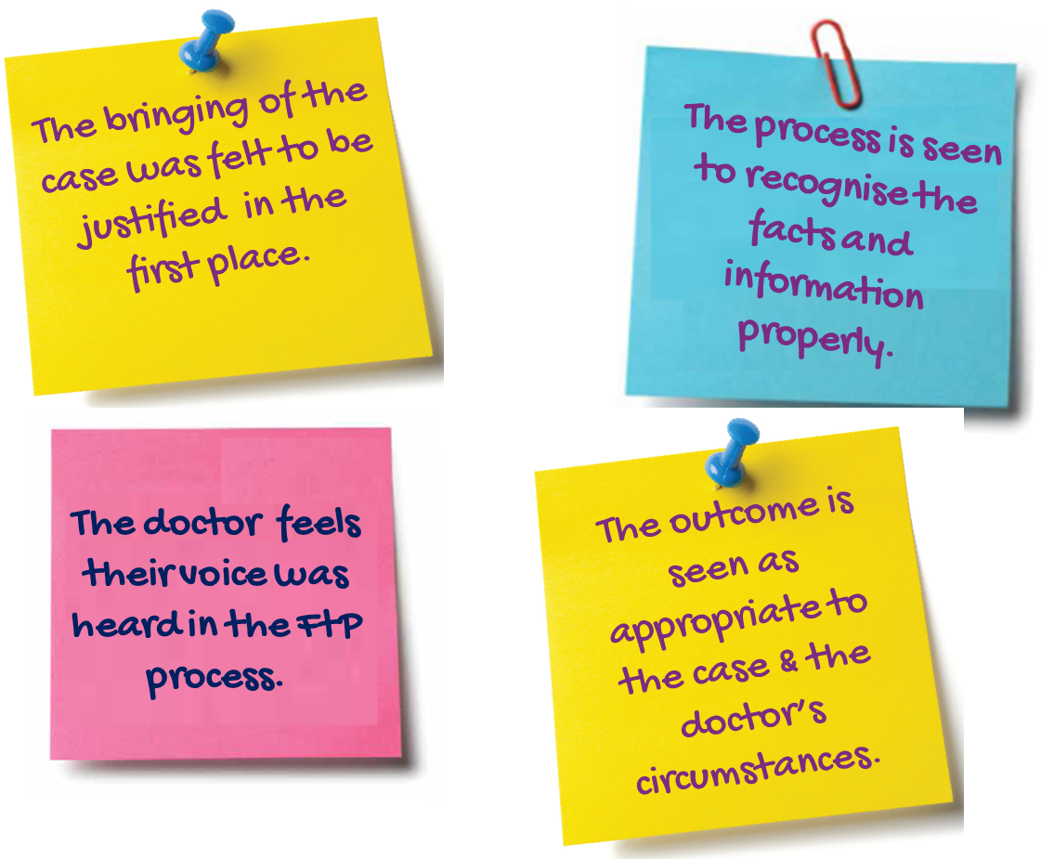
Perceptions affecting these drivers

Slide 14
Remediation can be easier in health cases
Doctors more often have insight and recognise the issue.
Willingness to reflect.
Employers and colleagues have more sympathy.
Easier to set up supervision arrangements.
GMC medical supervision is easy to arrange and widely viewed as supportive.
Enabling doctors to re-enter/re-establish themselves in the workplace.

Slide 15
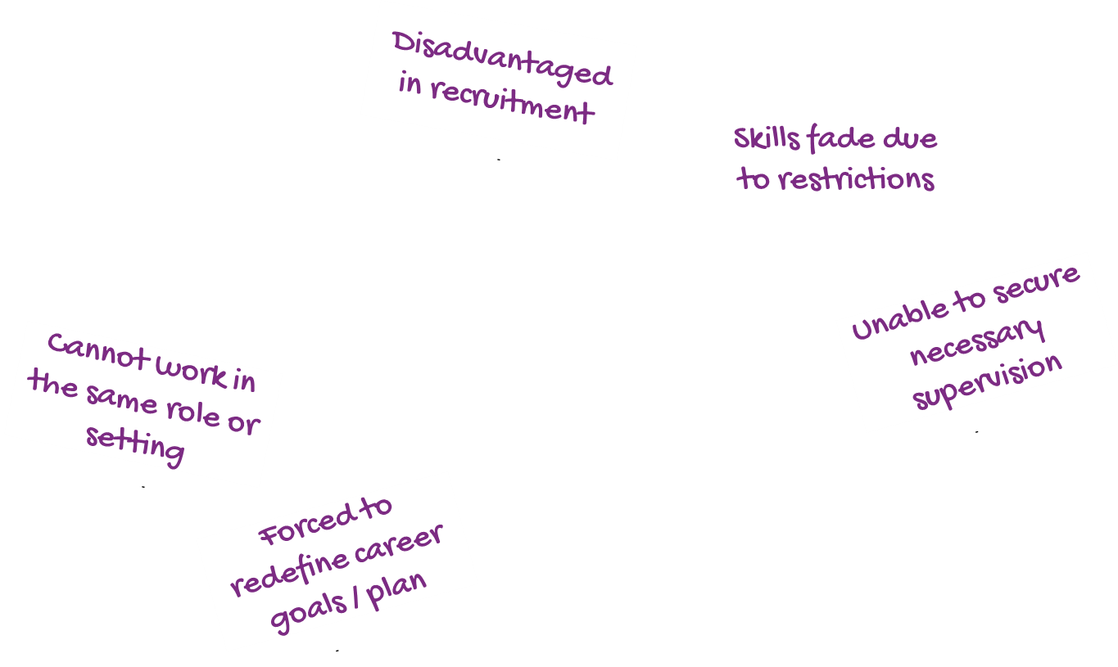
Career impacts
No impact at all
(warnings only)
Loss of confidence
Change of career path/ expectation / location
Long term stigma
Employment / progression difficulties
End of career

Slide 16
Participants’ suggested improvements
Tailored restrictions
Tailored warnings
Treating health cases differently
Working with employers
Notes:
Doctors had cases between 2006-2013.
So, current developments and recent changes were, therefore, not known or recognised.
Many suggested improvements relate to the FtP process itself (covered in our report.)

Slide 17
The effects of having restrictions on practice or warnings
GMC response

Slide 18
Responding to the findings
Finding: Voluntary restrictions more effective
Response: How to increase consensual outcomes
Finding: Some restrictions make it difficult for doctors to remediate
Response: Our experience and the challenges
Finding: Warnings can have a disproportionate impact
Response: Our plans to introduce a more proportionate approach

Slide 19
Questions and discussion

