Slide 1
Learning from International Comparison: the U.S.
Jean Moore, DrPH
Center for Health Workforce Studies
School of Public Health | University at Albany, SUNY
Friday 11 March 2016
Regulating for Positive Outcomes
Professional Standards Authority
Cumberland Lodge, Windsor Great Park

Slide 2
In the U.S., States Are Primarily Responsible for Regulating Health Professions
Competency/ Certification Requirements
Professional Qualifications
Education and Training
Title Protection
Licensure Process
Continuing Education
SOP Including Limitations and Exceptions
Discipline Process
Licensure Renewal
Describes Regulatory Body
Appeals Process
Definitions
State Regulations

Slide 3
State-Based Health Professions Regulation
Strengths
Supports workforce innovative responsive to local need and circumstance
Creates opportunities for states to learn from each other
Weaknesses
State to state variation in conditions for practice
Mismatches between professional competence and legal scopes of practice
Lack of uniformity in training, qualifications for some professions
Limits interstate mobility and innovation (telehealth)
Process for changing state regulations is slow, adversarial and costly

Slide 4
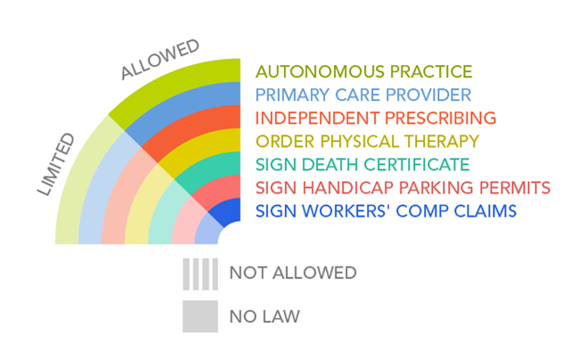
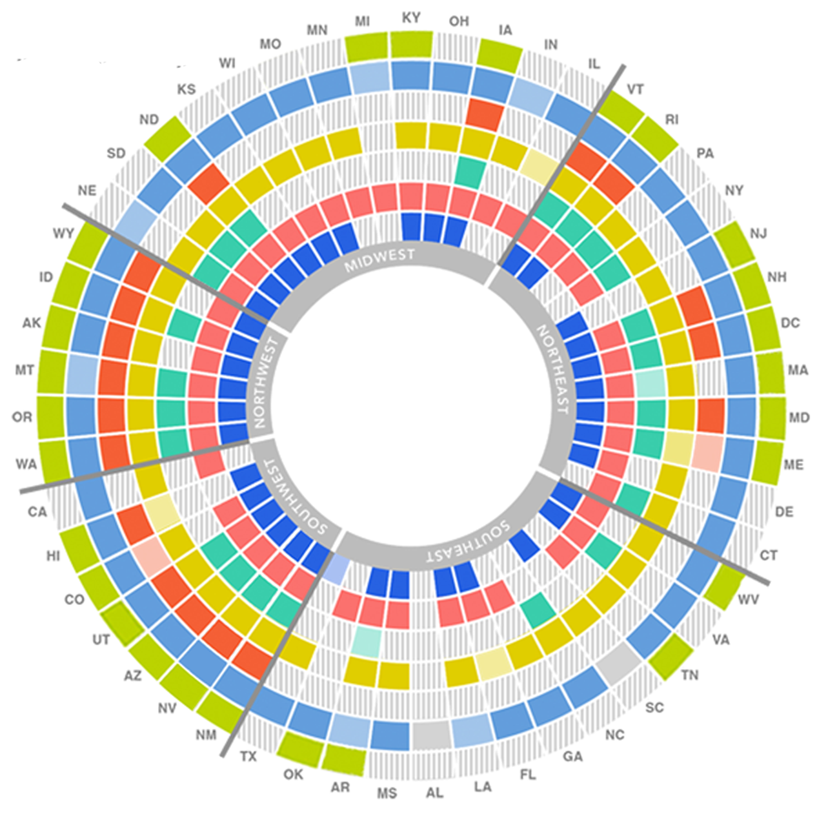
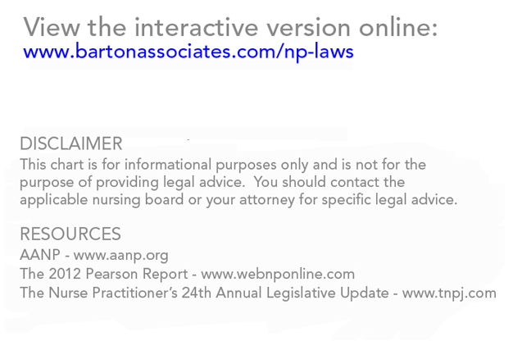
State to State SOP Variation: Nurse Practitioners

Slide 5
Failures of the U.S. System for Health Professions Regulation
Restrictive scopes of practice can limit access to care, making services more costly, with diminished capacity
Failure to consistently apply profession-specific national requirements for education and practice to state professional regulation
Failure to systematically evaluate workforce innovations

Slide 6
Opportunities
Health reform
Increasing use of interdisciplinary team based models of care
Most effective teams have shared responsibilities (scope overlap)
Payment reform
Moving away from fee-for-service and toward value based payment which focuses on outcomes of care
Focus on population health

Slide 7
Thank You

