Slide 1
The General Dental Council ‘Word of Mouth’ Patient Panel Regulating for positive outcomes Cumberland Lodge, 11 March 2016 Guy Rubin General Dental Council
www.gdc-uk.org
www.gdc-uk.org

Slide 2
Word Of Mouth Patient Panel
www.gdc-uk.org
Context
The panel: How does it work?
Putting patient experience at the heart of our work: 3 case studies
Future direction for the panel
Notes:
The GDC is the only health regulator to have a patient panel, The panel’s purpose is to put the patient voice at the forefront of the GDC’s approach to regulation. The presentation aims to give an overview of the panel’s work,
by explain how the panel works,
It flexibility used 3 quantitative and qualitative research that have delivered insight into patient experience and priorities and how those have to deliver tangible outcomes are reflected in regulatory policy
How we see the future of the panel.

Slide 3
Word Of Mouth Patient Panel
www.gdc-uk.org
Context
The Francis report (February 2013) recommended that health regulators should have more effective mechanisms for listening to patients and obtaining feedback
The Keogh report (2013) underlined the importance of engaging with patients
The GDC Council established the patient panel in 2014 as part of its response to the Francis Report – the first health regulator to do so.
Notes:
The implications of mid staffs tragedy,- centrality of patient voice in healthcare, reinforced on the need for health regulator to review the way they listened to patients.
One of the key messages was important of putting in place effective messages to hear patient voice.
Reinforced by Keogh
GDC considered its action plan in 2014, and establishing the patient panel was a key feature of this

Slide 4
Word Of Mouth Patient Panel
www.gdc-uk.org
Purpose:
To give a distinctive voice to the patient and public perspective about dentistry and dental regulation
Focus:
Capturing patient experience in relation to dentistry and dental regulation
Listening to patients and getting their input on key GDC policies and projects
Notes:
So what did we want to do:
Put patient and public protection at the heart of what we. IN particular to gain a fuller understanding of patients needs and expectations
What are the key issues of concern for patients by speaking directly to them.
To understand what patient experience of dental care and regulation in a range of settings.
Actionable insight that can reflected and drawn up on in developing policy

Slide 5
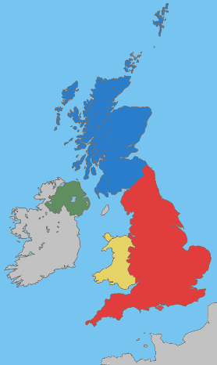
Word Of Mouth Patient Panel
www.gdc-uk.org
How does it work? (1)
5432 people, specifically recruited from a wider consumer panel
Independently managed by Community Research
Panel profile: recruited to be broadly representative of UK dental patients
Membership refreshed December 2015, targeting under represented groups (i.e. people 18-24 and 75+)
Notes:
Large panel – representative, boosters for Northern Ireland and Wales
Independence
Profile of dental patients
Nhs, private, types of patient, regular, less regular, satisfied and less
satisfied etc

Slide 6
Word Of Mouth Patient Panel
www.gdc-uk.org
How does the panel work? (2)
Operates mainly online.
Members ‘opt in’ to take part in regular research and engagement activities (surveys, workshops, discussion groups, telephone interviews)
Regular newsletters keep members informed of outcomes of research ‘you said we did’
Notes:
Flexibility
Recruited to work online but extended that innovate.
Key to keeping engagement is to keep panel members informed and aware about how their views are reflected

Slide 7
Word Of Mouth Patient Panel
www.gdc-uk.org
Case Studies:
Duty of Candour (Focus Groups)
Recent Dental Appointments (Survey)
GDC Roadmap (Workshop)
Notes:
Three case study
Drawn form wider range of research
Propensity to complaint
Website
Focus on three different ways we have use panel – Qual and Quant

Slide 8
Duty of Candour
www.gdc-uk.org
Objective:
Patient views and expectations when things go wrong with their treatment or care
Expectations
Methodology:
Focus groups in England and Scotland (Feb 2016)
Key Findings:
Proportionate response
informing patients about mistakes was key to duty of care
Robust systems in place to learn from mistakes including ‘near misses’
Notes:
The GDC is currently reviewing its Duty of Candour guidance, the primary document that sets out the behaviours and values expected of dental professionals when things go wrong with dental treatment or care.
Ensuring at professional respond appropriately when something goes wrong it at key to our standards work as health regulator and that meet patient expectation
Series of scenarios –
Breach of confidentiality
Late running and minor accident
Mistaken identity
Misreading a radiograph
Treatment costing confusion

Slide 9
Duty of Candour
www.gdc-uk.org
Outcome:
Findings from the research are feeding into review of draft guidance
"We would hope that the actual practice would be completely transparent and tell you your options for remedies and also speaking to the GDC." (London participant)
"You’ve got to apologise with an indication of what you’re going to do about it as well. So accept responsibility and also show how you’re going to go about rectifying the damage." (Glasgow participant)
"If it’s a real person to person apology, rather than a professional one, then you would probably take it more [seriously]." (Glasgow participant)
Notes:
Key elements of research that are feeding in
Linking apologies to remedy
Transparency about what will happen
Interesting use of professional – it is all about tone and sincerity – key to how it be received

Slide 10
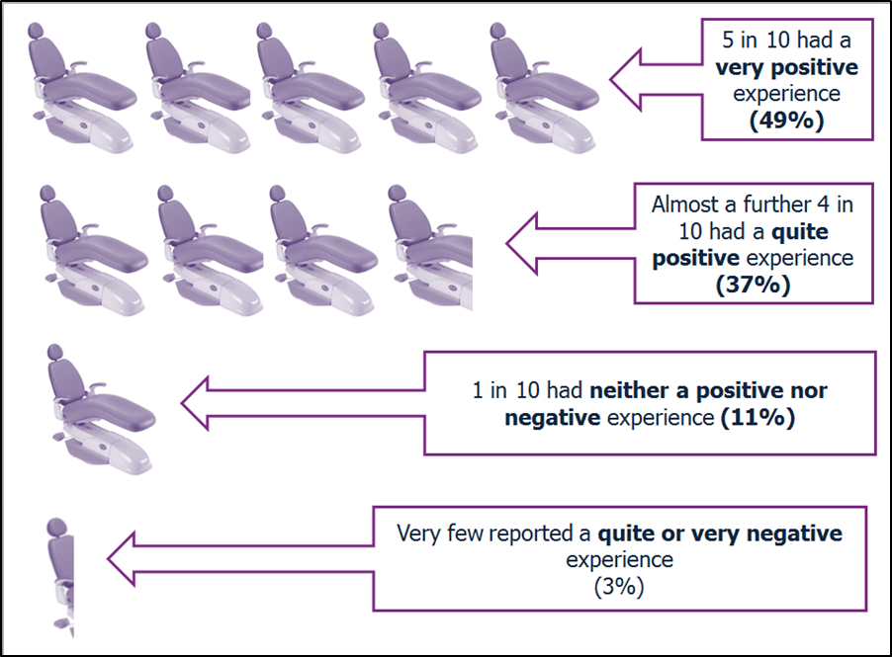
Recent dental appointments
www.gdc-uk.org
Objective:
Explpore patients’ experiences and the extent to which GDC Standards are being met
Methodology
Two surveys carried out in 2015 with 1052 panel members who had a dental appointment within the last month
Key Findings
Vast majority said that the benefits and risks of treatment were explained and gave informed consent
Notes:
Introduced new standards for patients – put patients interest fist
Include patient expectations –
How are they being experienced?
In general positive
Planned and unplanned
Finding = broadly encouraging
Benefit and risk /informed consent

Slide 11
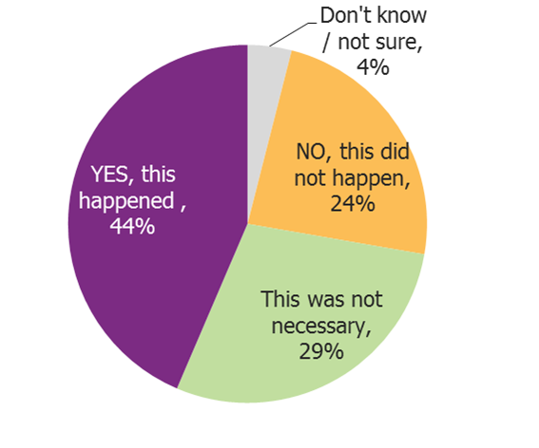
Recent dental appointments
www.gdc-uk.org
Figure 11 – The cost of my appointment was clearly explained to me in advance
Results..
1 in 4 said that costs were not explained in advance or that they did not see a price list on display
Outcomes
Direct evidence from patients in monitoring and evaluating adherence to the standards
Notes:
However key aspect of standard that are key to patient where the picture was more mixed 44% yes – 28% just under a third not the case.
29% check up of follow up
Key issue – lack of clarity about costs – nhs/private – feeds into wider concenrs about communication and trust
Using this evidence –
Valuable evidence to monitor standards –directly feedback
Further research with registrant Further resarch – treatment plan .
Feed into our communication with registrant about the important of this
Work partners system regulators, nhs and dental profession ensure patients are provided with clear info on cost of dental care a treatment plan and all the info need to make informed decisions on their care

Slide 12
GDC Roadmap 2016-19
www.gdc-uk.org
Objective:
Patient voice and input into the development of the GDC’s roadmap 2016-2019
Methodology:
Deliberative workshop with cross section of patient panel members – a different way of working with the Panel
Notes:
Roadmap - patient at hear of our work over the next feed year -sets out policies and objective
Demonstrate different way of working panel – effective at capturing patient voice
Key was translating into themes relevant to patient – so not abstract – real related to patient experience – tangible
Sub groups on
Expectations of dental professionals and dental services
Ageing Population
Patient vs Consumer
Judging Quality
Complaint

Slide 13
GDC Roadmap 2016-19
www.gdc-uk.org
Key Findings:
Attitudes towards dentistry are changing
Local Resolution
Patients focused on the importance of treating those with more complex needs (e.g. dementia) and the specialised knowledge and skills required. (e.g. communication skills tailored to patients/carers)
Outcome:
Patient views are reflected in aims and objectives for patients set out in the roadmap
Notes:
younger patients more likely to “shop around” in a consumer manner, whereas older patients more likely to see dentistry as “healthcare” and stay with same dentist
: Many patients look to resolve issues locally in the practice, but some would consider voicing their issues online, in forums to ‘name and shame’ or in ratings systems.
Outcomes – examples from Janet’s paper – major focus on complaints and resolving them at the most appropriate level
Compled needs – ojective around promote and enforcing standarsd that take full account of patins needs nad legitimate expectations
Fed back to all panel members through a newsletter.

Slide 14
Word Of Mouth Patient Panel
www.gdc-uk.org
Next steps….
Explore the potential for joint working with health care regulators and stakeholders in using the panel
An evaluation of the performance and effectiveness of the panel
Notes:
Started with welsh government –anti-biotic
Joint research – isssues of interest to some or all of us
Specific bespoke research – also consume other heatlhcare service s
Flexibility – size, quick turnaround
Evaluate perfomance

Slide 15
Questions?
www.gdc-uk.org
Guy Rubin:
Research Manager
email: grubin@gdc-uk.org
GDC website: www.gdc-uk.org
Follow us on social media
Notes:
Conclusion
Flexibiltiy
Range of activies
How it generates tangible and actionable insignt about patient experience and priorities
Next steps

