Slide 1
Using regulatory data for prevention and shared assurance
David Darton, Head of Intelligence and Insight

Slide 2
Presentation today
Can we combine intelligence from professional regulators and intelligence from the health system to increase our effectiveness at risk-based regulation, beyond sharing critical and immediate patient safety intelligence
Presentation of data analysis to understand whether and how data about professional standards (in terms of fitness to practice) relates to data about the work environment (in terms of CQC ratings or a trust being put into special measures)
Presentation of an approach we are now taking forward to further our understanding of risk beyond this.

Slide 3
A priori evidence that work environment might impact on professional standards
For example from work done by RAND for the GMC:
Workload pressure can lead to doctors taking shortcuts
Limited time for reflection
Organisational culture can discourage doctors from raising concerns
Concerns not listened to

Slide 4
This statistical analysis is a case study looking at acute trusts in England
Large group of organisations – 161 trusts
Data used:
the GMC’s fitness to practise processes
National Training Survey (NTS)captures doctors’ perceptions of the trust through four indicators
CQC inspection ratings data
Special measures

Slide 5
Conclusions – rest of presentation looks at evidence for each
Elevated levels of ftp activity in 2010-2014 in trusts that went into special measures or got poor CQC ratings
Complaints more than sanctions – the importance of ‘noise’
Limited evidence that ftp activity increases about two years before a trust gets put into special measures
Complaints/Investigations more than sanctions
A trust going into special measures is not a useful predictor of future ftp activity on its own.
NTS data not useful for prediction at single Trust level

Slide 6
Elevated levels of ftp activity in 2010-2014 in trusts that went into special measures or got poor CQC ratings

Slide 7
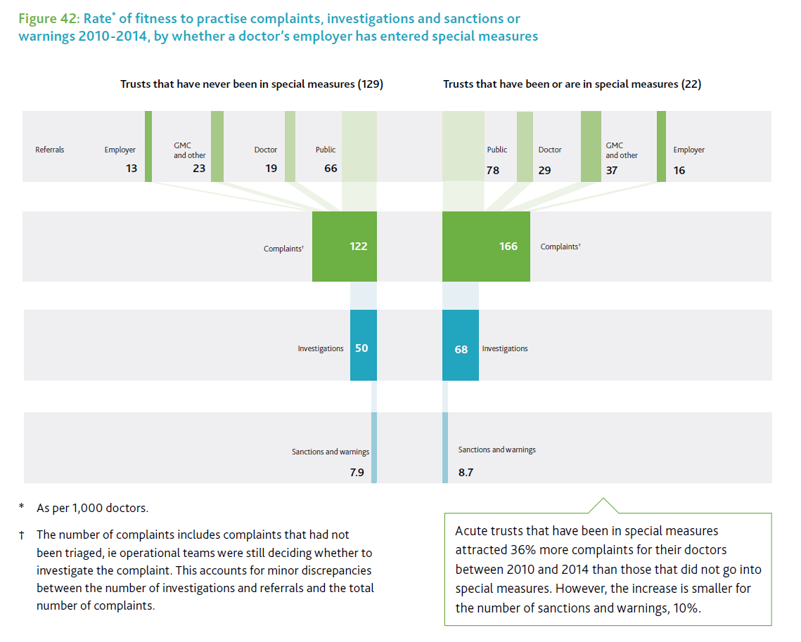
Special measures

Slide 8
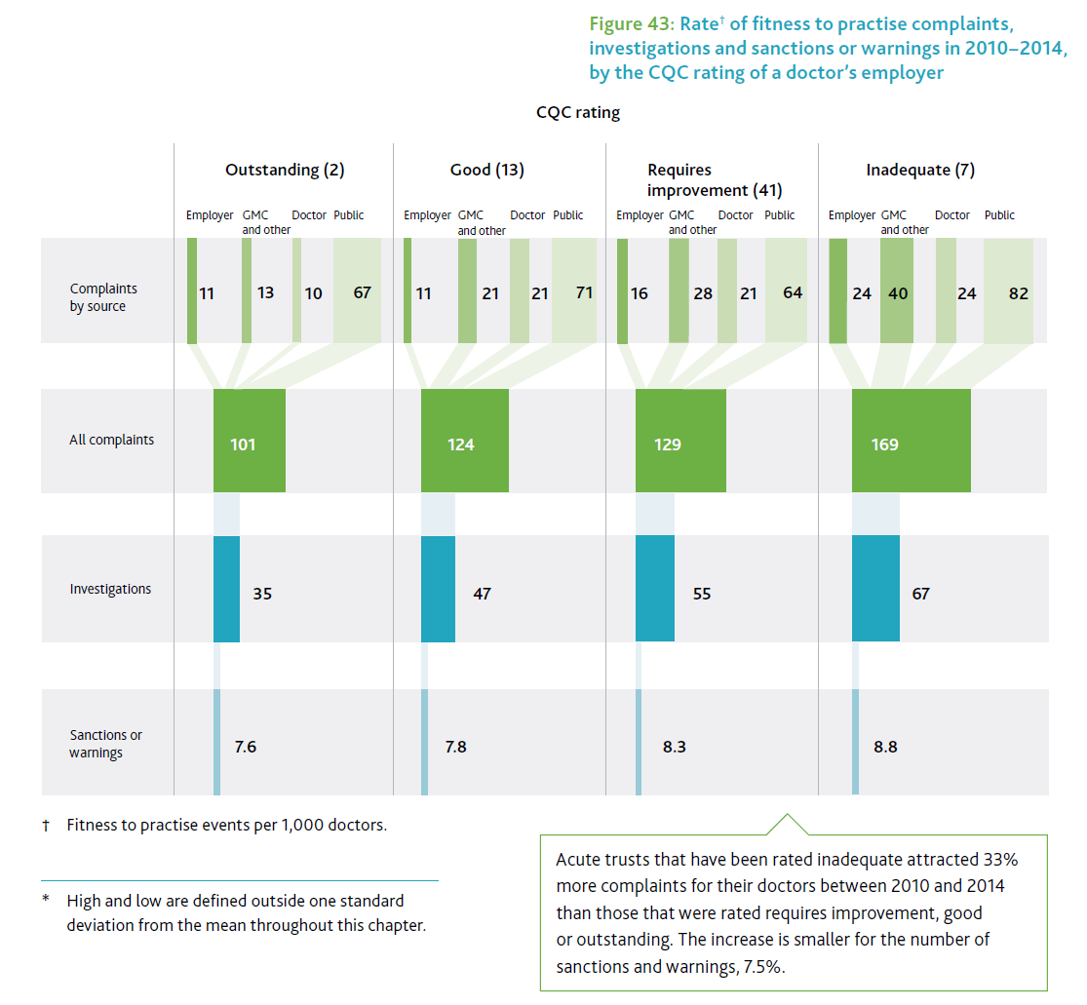
CQC rating

Slide 9
Limited evidence that ftp activity increases about two years before a trust gets put into special measures

Slide 10
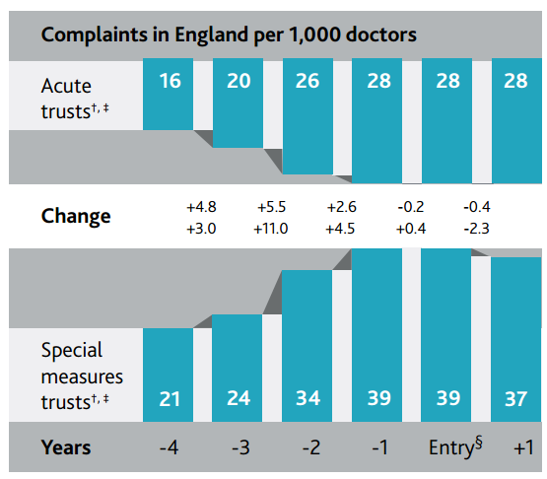
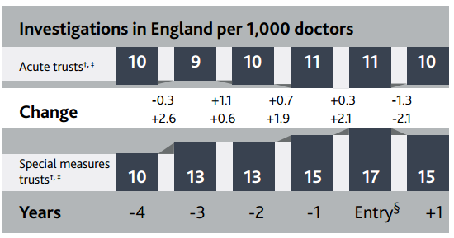
Complaints and investigations about doctors, before and after their provider was put into special measures*

Slide 11
Notes relating to previous chart for reference
* For this analysis, a weighted average for trusts that have never been in special measures was taken based on the date range used for trusts in special measures.
† Because the 22 providers that entered special measures in the relevant time period did so on different dates, the comparison figure for all acute trusts has been arrived at by weighting different dates.
‡ For some providers, there has not been a full year of data, so what data they have have been included with a proportional discount to reflect their limited time in this period.
§ ‘Entry’ denotes the period 6 months before and after entering special measures. Likewise, the years before or after refer to a 12-month period, so 1 year before, for example, is from 18 months before to 6 months before entering special measures.

Slide 12
A trust going into special measures is not a useful predictor of future ftp activity on its own.

Slide 13
Findings
The fall in complaints was greater in trusts once in special measures than those trusts not in special measures over same time period
But the proportion of a trust’s doctors referred to and investigated by the GMC after special measures varied too much for special measures generally to be a useful predictor of the proportion of doctors who will then become involved in FtP processes in an individual trust

Slide 14
NTS data not useful for prediction at single Trust level

Slide 15
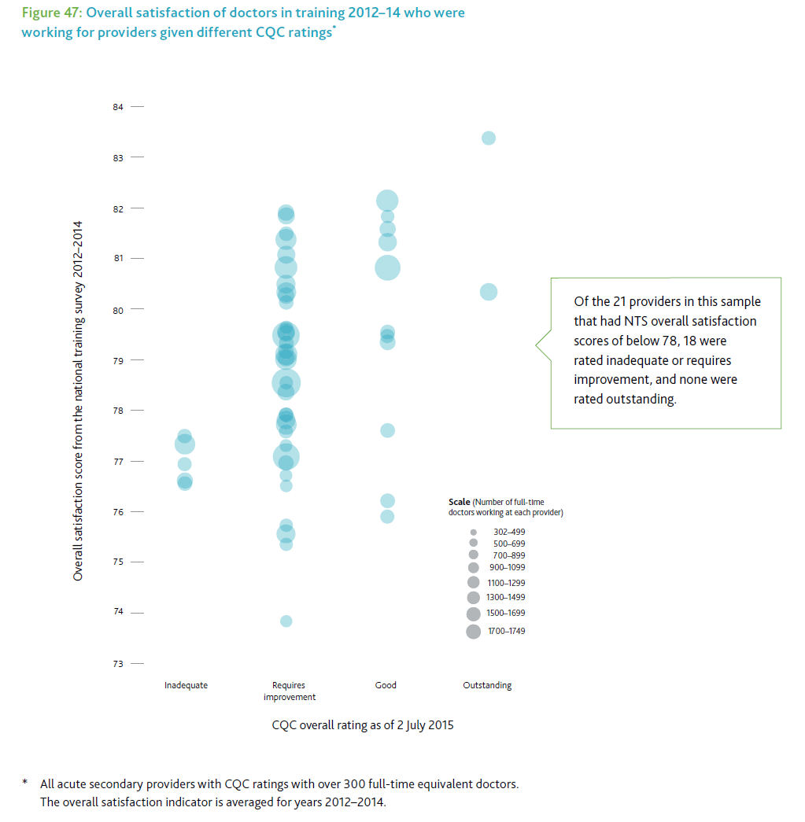
NTS data and CQC ratings

Slide 16
Findings
Doctors’ satisfaction with their training posts is higher in trusts rated Outstanding by CQC compared to those rated Inadequate
However for Good and Requires Improvement trusts there is too much variation for this to be an effective indicator
Doctors’ satisfaction with their training environment and clinical supervision declined during the year a trust goes into special measures but not thereafter

Slide 17
Limitations, conclusions and next steps

Slide 18
Limitations of analysis and tentative conclusions
Complexity and variety of Trusts not taken account of
Performance of individual departments not included
+++++++++++++++++++++++++++++++++++
Results suggest that a sharper than average increase in ftp complaints/investigations is a risk factor for future special measures two years ahead and a generally higher level of ftp activity is associated with poor overall Trust performance. Needs further research.
Poor overall Trust performance is not a good predictor of ftp activity in the future.
NTS data at the trust level is not a good predictor of overall trust performance or vice-versa.

